Slide 1
Laundry WebApp
By - Japesh Sikri (189302141)
& Harsh Rajput (189302133)

Slide 2
Introduction
This is a webapp aimed to digitalise the manual record keeping of laundry submissions in hostel which is currently done on paper.

Slide 3
Motivation
Every time we as students submit or take back our laundry we have to manually make on entry on a piece of paper.
These records aren’t very safe or efficient.
So we decided to digitize it!

Slide 4
Django Framework
We have developed the entire backend of our website on the Django framework of python.
Django’s Object Relational Mapper(ORM feature which enables user to interact with database without writing raw SQL queries) along with other amazing modules like User Model, Authentication System etc, provides an easy way to maintain and extend the application, which is critical for a website like Laundry Webapp.

Slide 5
Database
The database we have used in this project is SQLite database which comes as default with a Django project.
SQLite is user-friendly and easy to manage as it require no configuration from developers’s end.

Slide 6
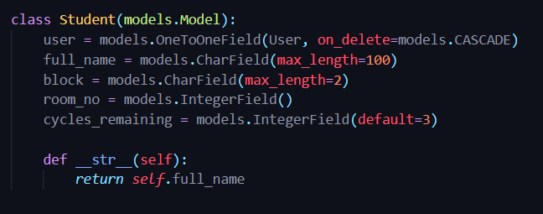
Student Model
To add student-specific attributes like Block, Room Number, No. of cycles remaining of an user, we have extended
User Model via one-to-one link and created a new model “Student” which will store extra information that relates to the user model.

Slide 7
User Interface
Django allows template inheritance which facilitates the development of base template which can latter be inherited by all other templates.
The UI was developed using Tailwind CSS with responsiveness and mobile readiness and primary goals.

Slide 8
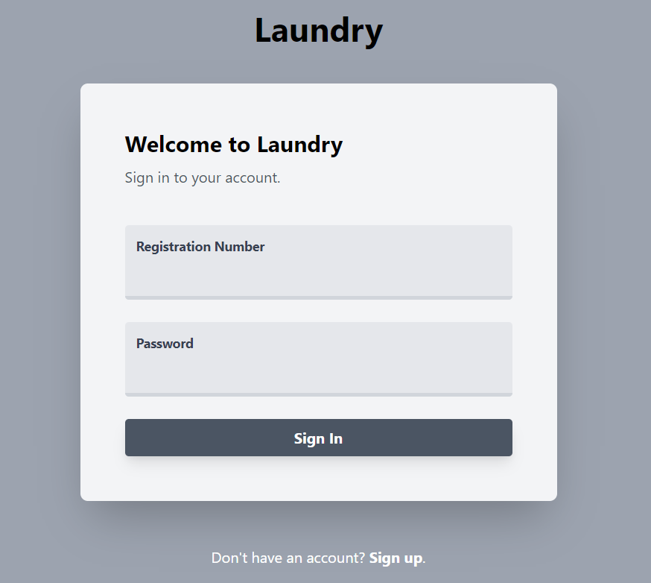
Login Page
A basic login page made with tailwind css.

Slide 9
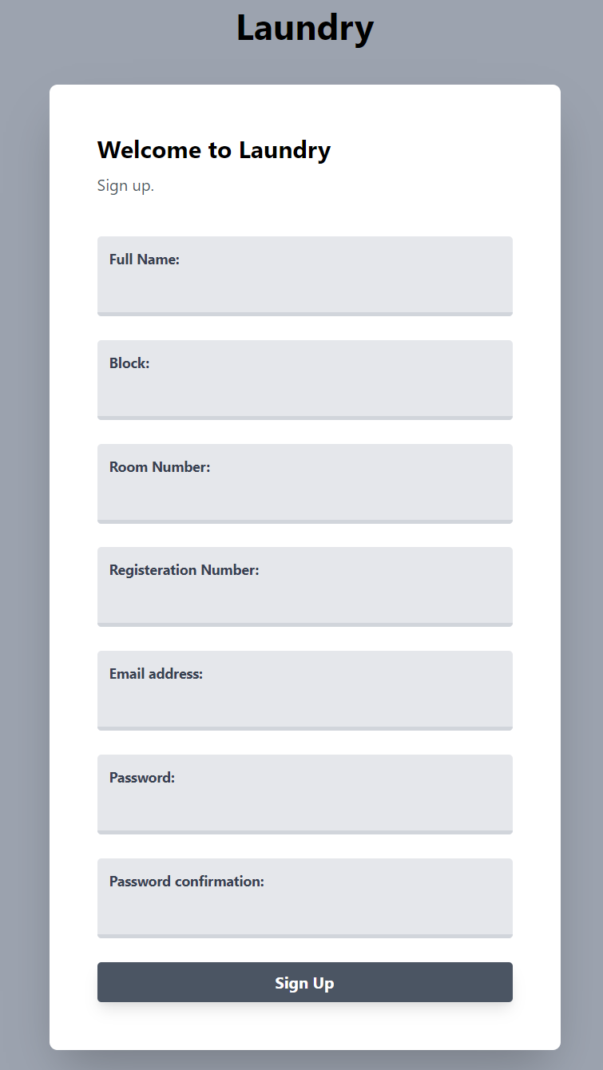
Signup Page
A basic login page made with tailwind css.

Slide 10
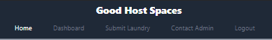
Navbar
A basic navbar to navigate through the pages responsive to mobile devices as well.

Slide 11
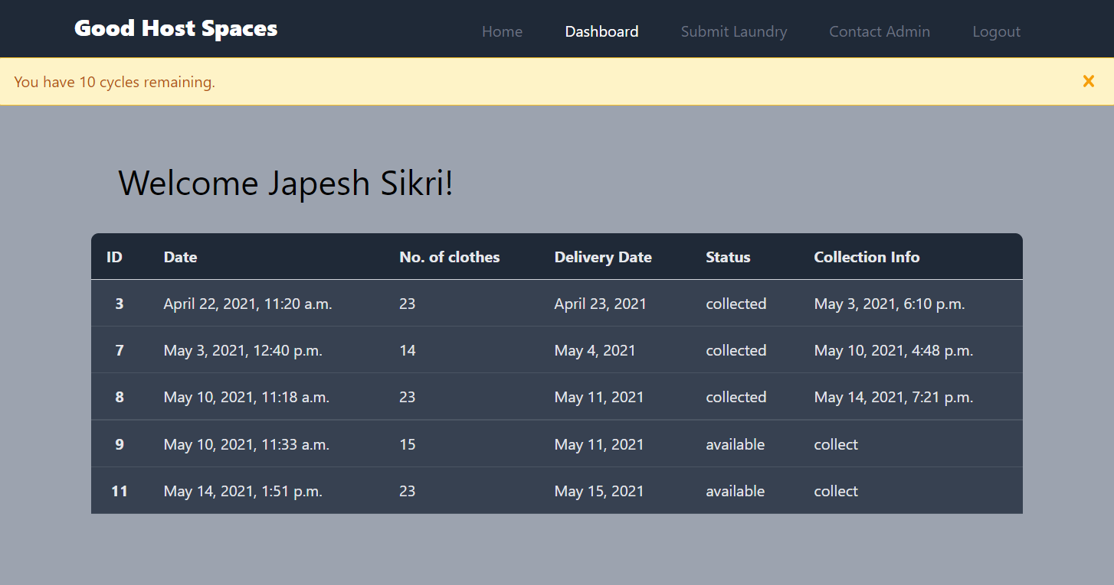
Dashboard

Slide 12
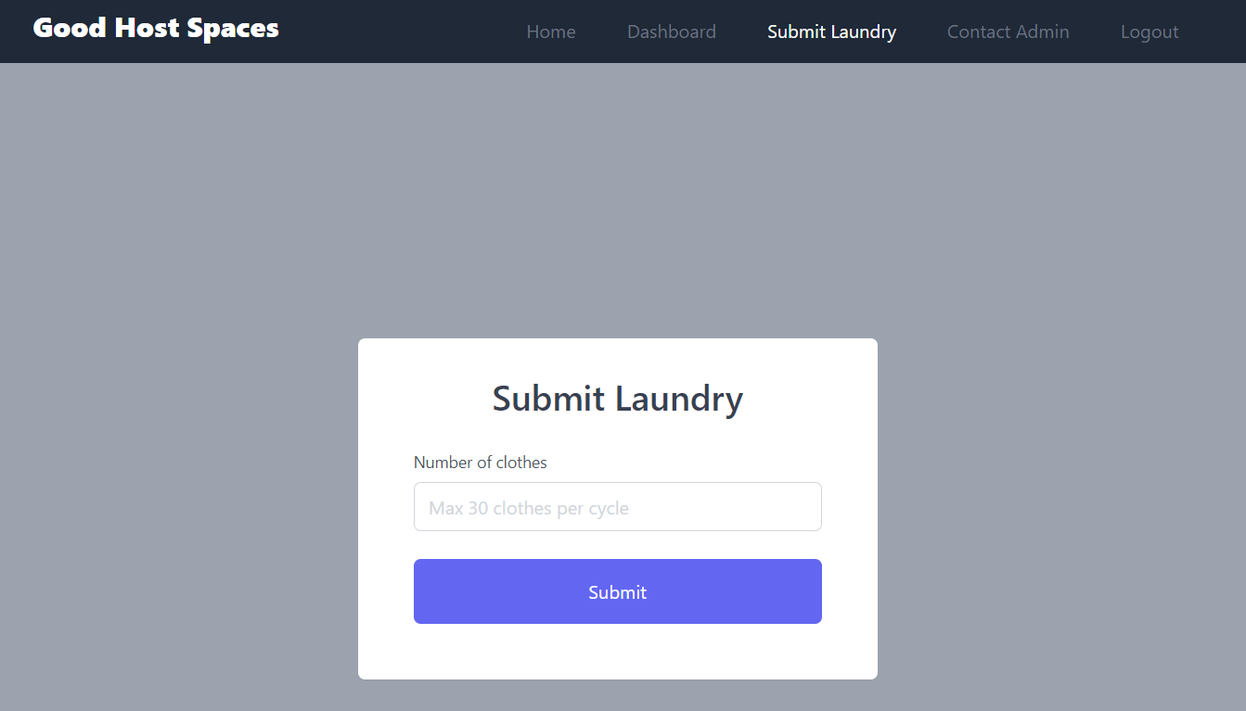
Submitting the laundry

Slide 13
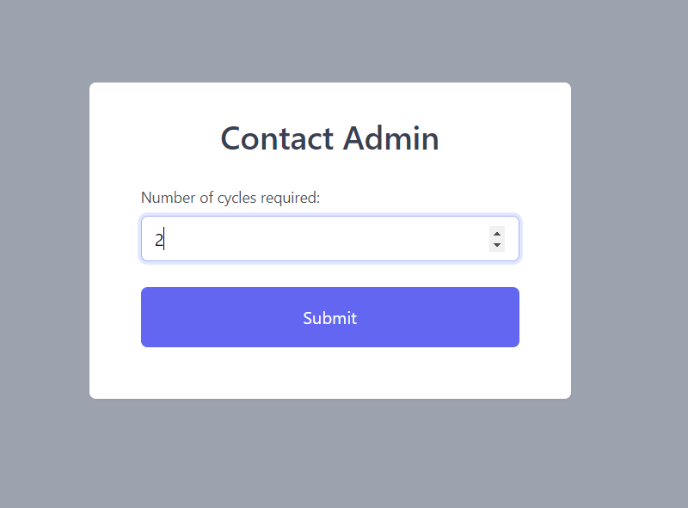
Contact Admin

Slide 14
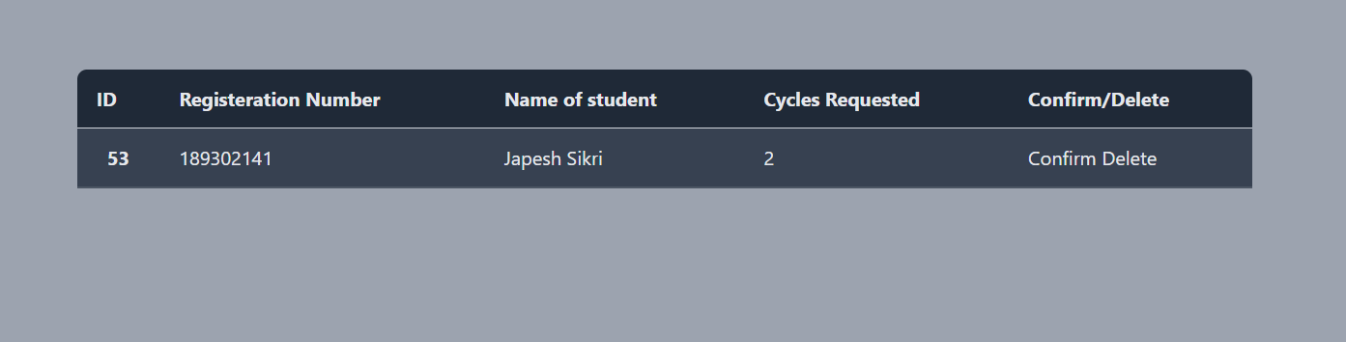
View Requests

Slide 15
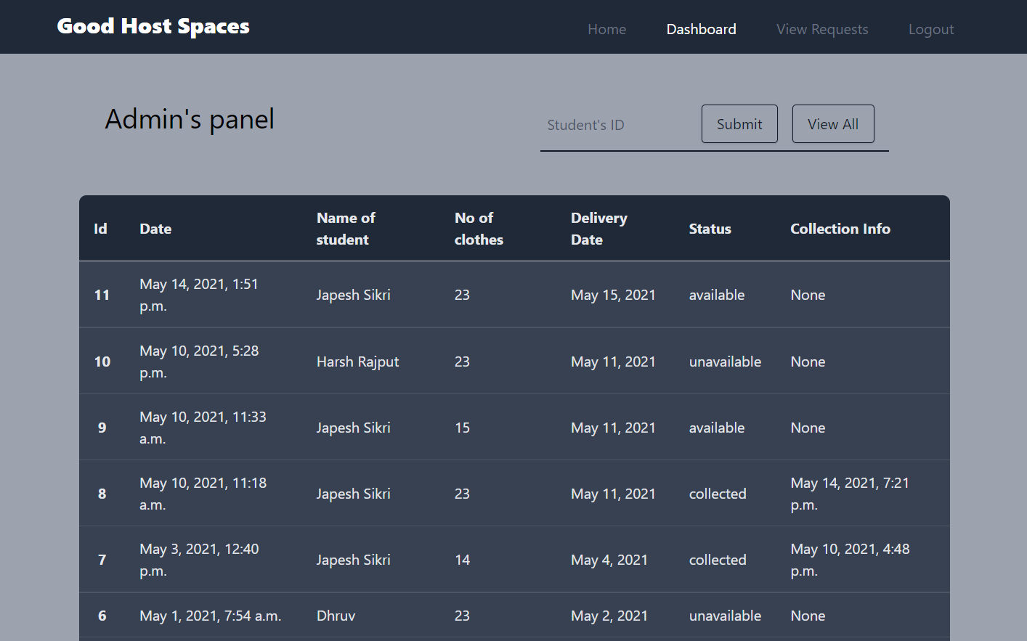
Admin Dashboard

Slide 16
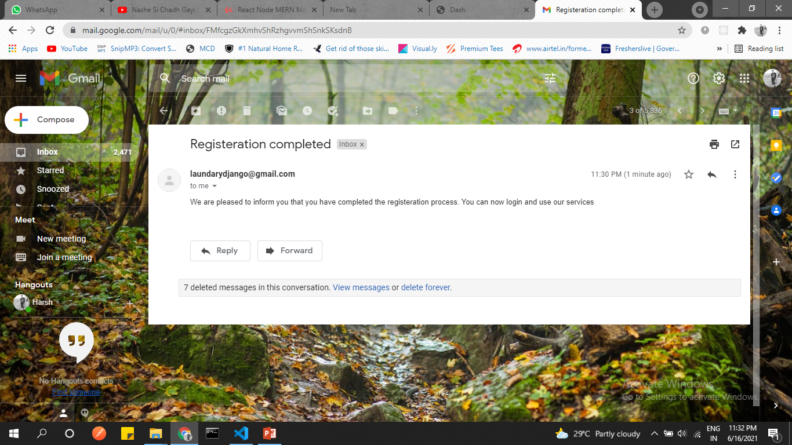
Email

Slide 17
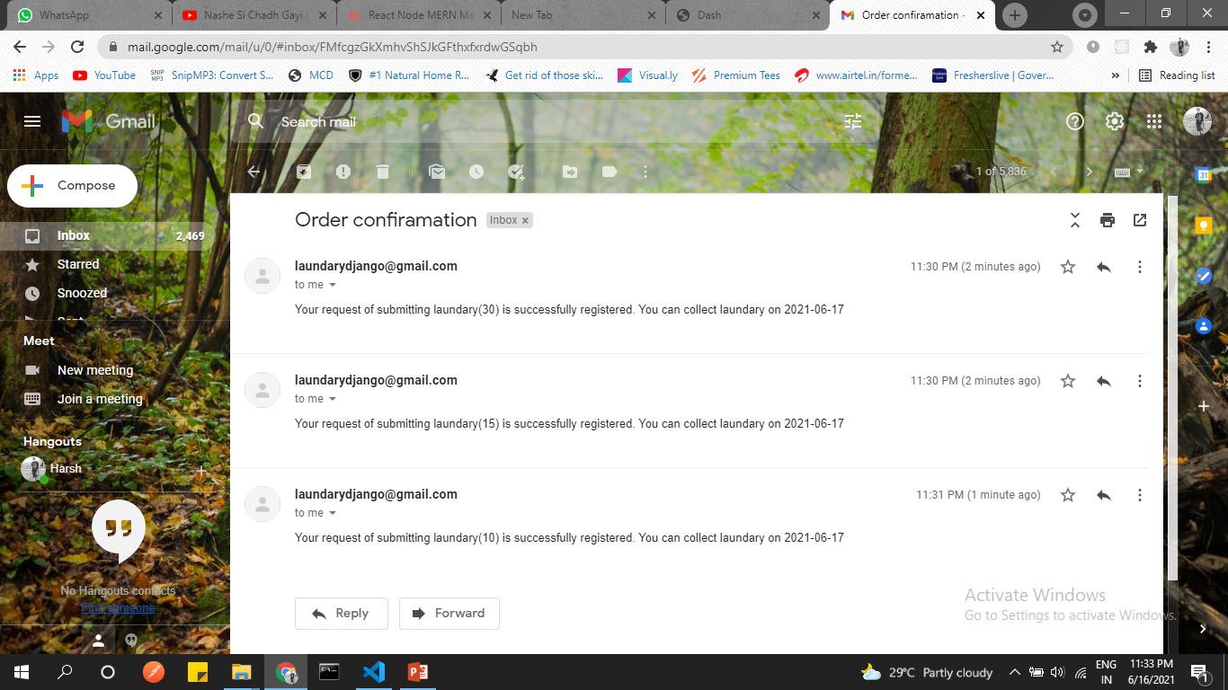

Slide 18
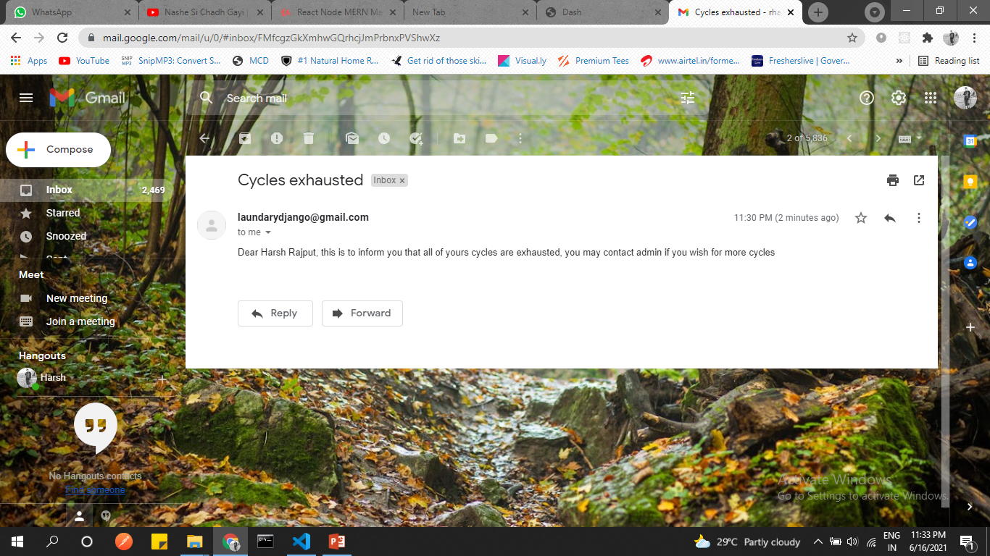

Slide 19
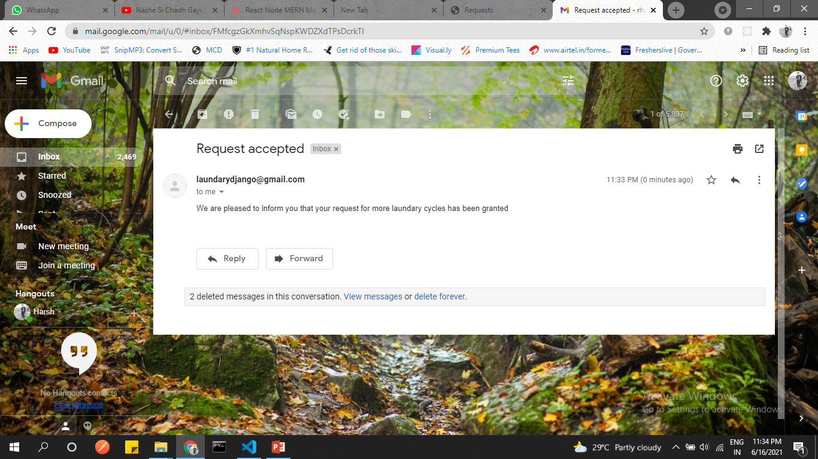

Slide 20
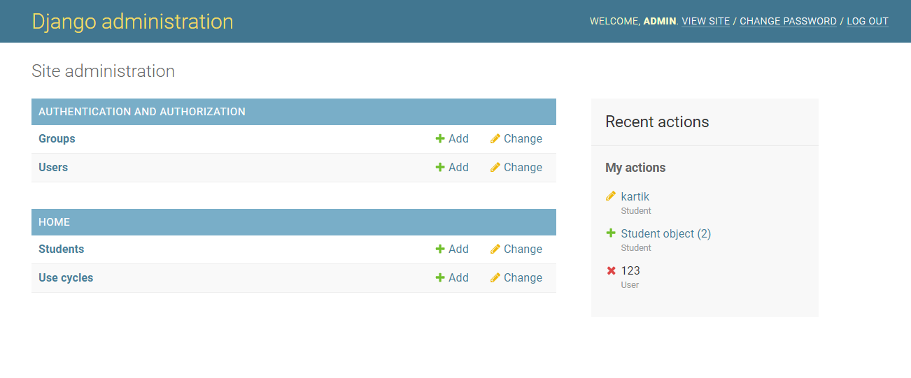
Django Administration
The section of the webapp that can only be accessed by the administrator.

Slide 21
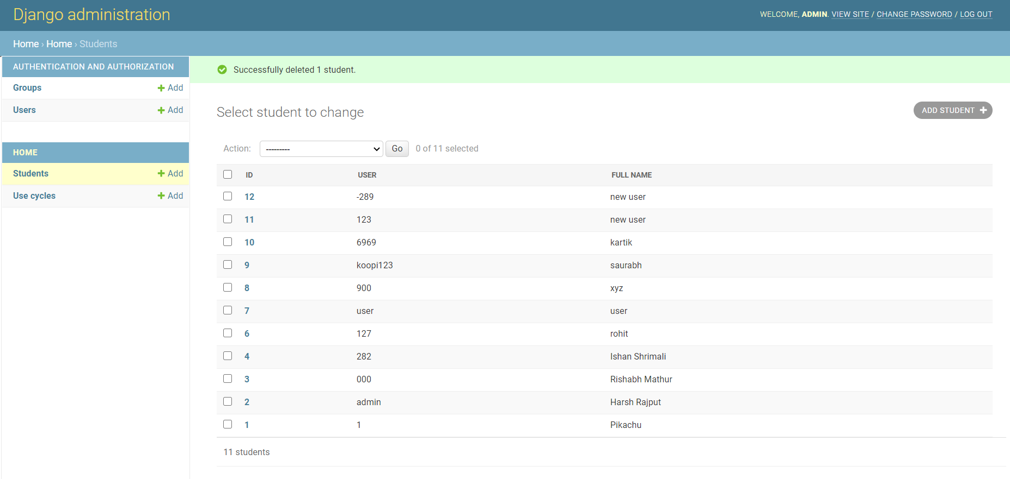

Slide 22
Project Links
Github: https://github.com/4doctorstrange/Minor-Project
Heroku: https://mujlaundaryapp.herokuapp.com/

Slide 23
Thank You
Project Guide: Mr. Ashish Jain
Members: Japesh Sikri & Harsh Rajput

